Slide 1
A Comprehensive Guide to Dart Programming
Object Oriented Principles , Functional Concepts
MODULE 3
CHAPTER 2

Slide 2
OBJECT ORIENTED PROGRAMMING IN DART
Dart is an object oriented programming language.
Object oriented program ( OOP ) makes programs easier to understand, modify, reuse, and maintain.
The OOP concepts in dart is to reduce programing and can execute many task at once.

Slide 3

OOP
OOP is a programming method based on objects and classes.
Class is a blueprint or template.
Object is an instance of a class.
Pillars of OOPs
Encapsulation
Inheritance
Polymorphism
Abstraction

Slide 4
CLASS
A blueprint or template for creating objects.
Compare to other languages CLASS have less importance in dart.
It used to declaring , allocating space , storing , etc.
The class keyword is followed by the class name.
SYNTAX
class ClassName {
// properties (variables)
// methods (functions)
}
There are 4 types of attributes :
Fields
Getters / Setters
Constructors
Functions

Slide 5
Four types of attributes :
FIELDS : variables that store data for objects.
GETTERS / SETTERS : getters are methods that retrieve the value of a property , setters are methods that update the value of a property.
CONSTRUCTORS : special functions that create instances of classes.
FUNCTION : refer to the action an object can take.

Slide 6
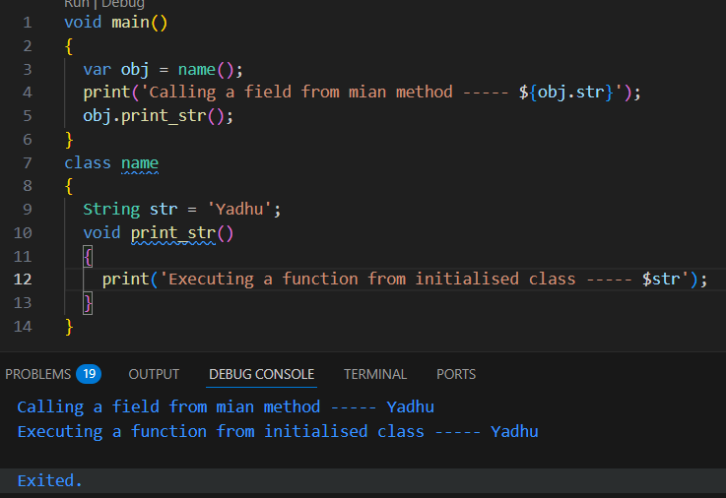
OBJECT
Objects are instances of classes and have properties and methods.
SYNTAX
ClassName objectName = ClassName();

Slide 7
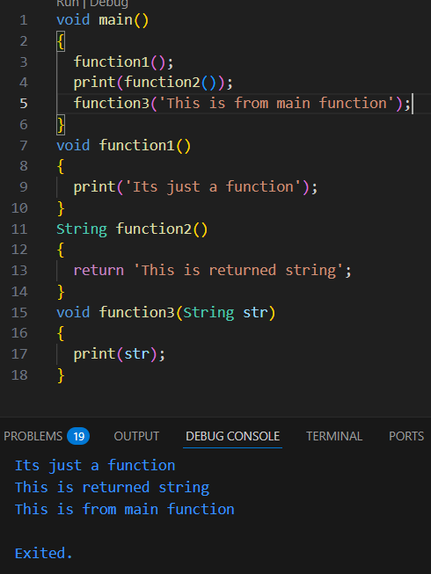
FUNCTION
Defining Function : A function definition requires when and how a specific task would be done.
Calling Function : A function must be called in order to execute it.
Returning Function : A function may also return values back along with the control, to the caller.

Slide 8
PARAMETER FUNCTION
POSITIONAL PARAMETER : It use to square [] brackets.
NAMED PARAMETER : The parameters name must be specified while the value is being passed.
DEFAULT PARAMETER : The function parameters can also be assigned value by default.

Slide 9
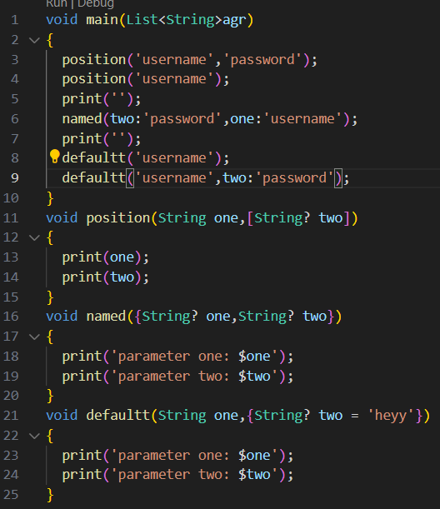
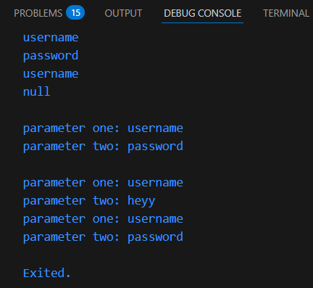

Slide 10
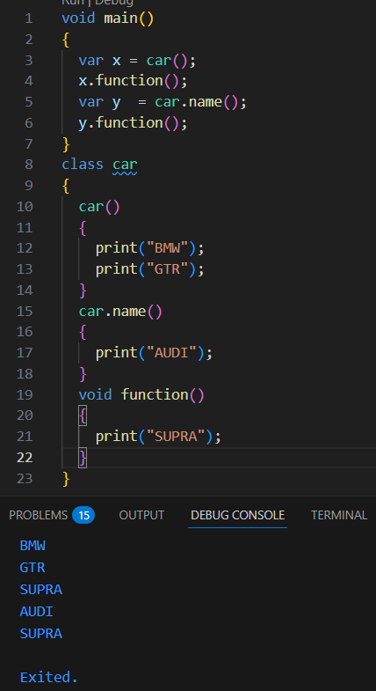
CONSTRUCTORS
A function which we will create with the name itself.
Which will execute automatically when the class is called.
There are named constructors in dart.
Which will allow us to create and call by the default name we create.
The constructor will only execute only if its called by that name.

Slide 11
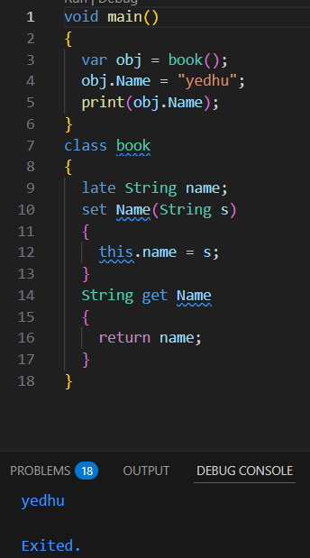
SETTERS / GETTERS
Getters or accessors are defined using get keywords.
Setters or mutators are defined using set keyword.

Slide 12
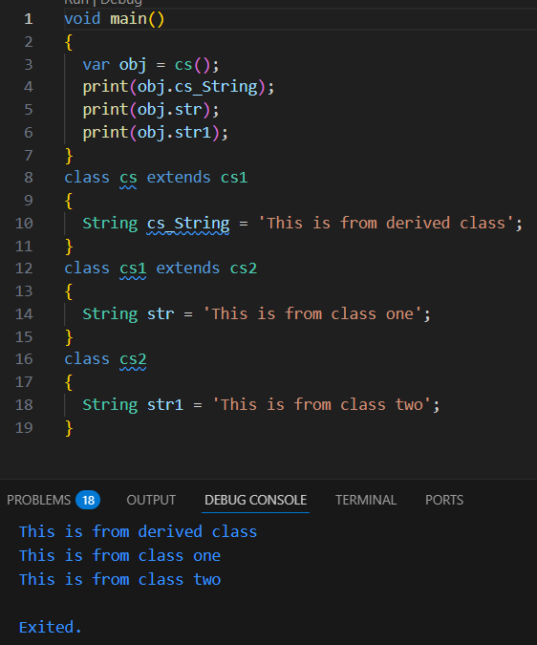
CLASS INHERITANCE
It is used to access a class (parent class) by another class (child class).
The inherited class object by making the object of derived class.
Commonly used Inheritance :
Single Inheritance.
Multi - level Inheritance.
Hierarchical Inheritance.

Slide 13
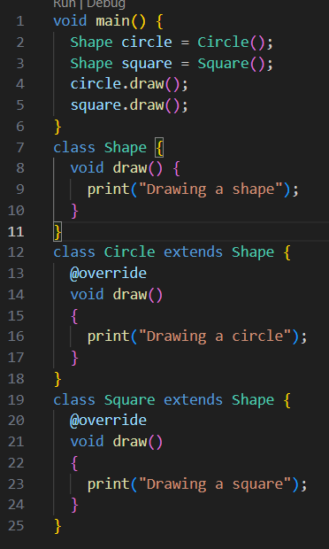
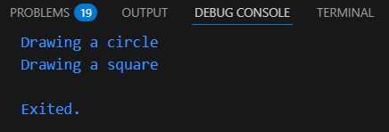
POLYMORPHISM
It is the ability of an object to take many object.
2 types of polymorphism :
Compile time.
Run time.

Slide 14
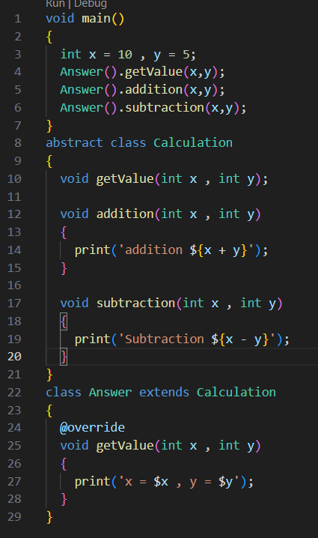
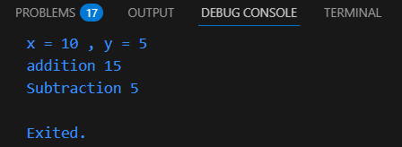
ABSTRACT CLASS & METHOD
ABSTRACT CLASS :
Use abstract keyword to declare abstract class.
It cannot be instantiated and cannot create object but can be inherited.
ABSTRACT METHOD :
To make a method , use semicolon ( ; ) instead of method body.
It can only exit with abstract class.
You need to override abstract method in subclass

Slide 15
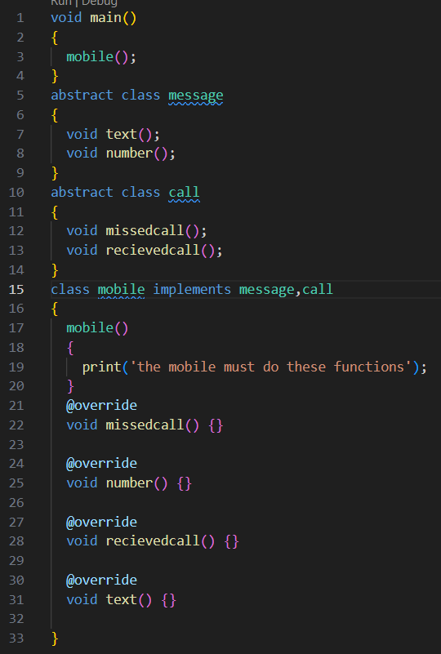
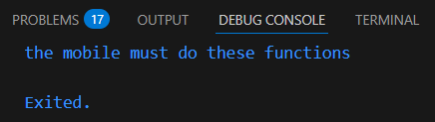
INTERFACE
Dart does not have special syntax to declare interface.
An interface in dart is normal class.
You can implement multiple classes but you cannot extend multiple classes during inheritance.

Slide 16
Feature | this Keyword | super Keyword
Definition | Refers to the current instance of the class. | Refers to the parent (or superclass) instance of the current class.
Purpose | Used to access current class members | Used to access parent class members that are overridden or hidden in the child class.
Access Scope | Current class only. | Parent (superclass) only.
Common Uses | 1. Access current class variables. 2.Call current class methods. 3. Call one constructor from another constructor (constructor chaining). | 1. Access overridden methods of parent. 2. Access hidden parent class variables. 3. Call parent class constructor.

Slide 17
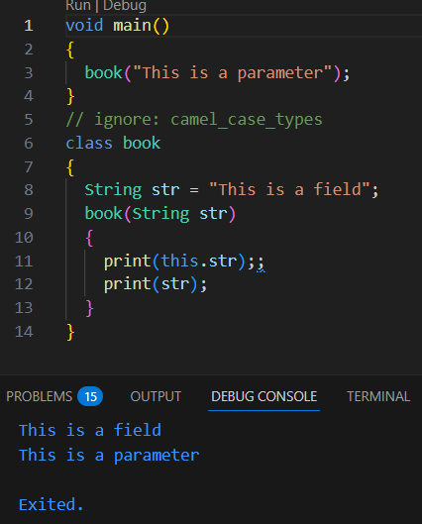
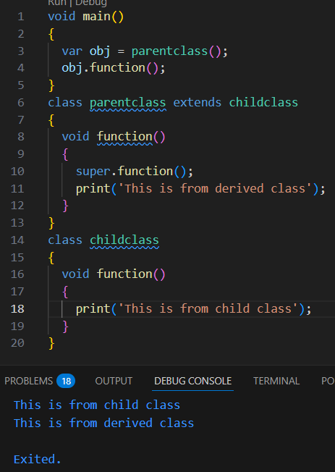
THIS KEYWORD
SUPER KEYWORD

Slide 18
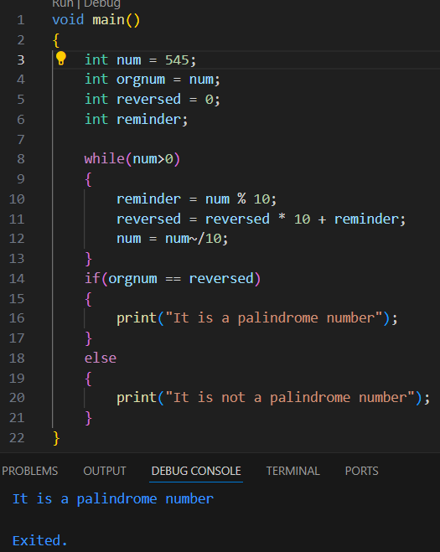
EXERCISE - 1

Slide 19
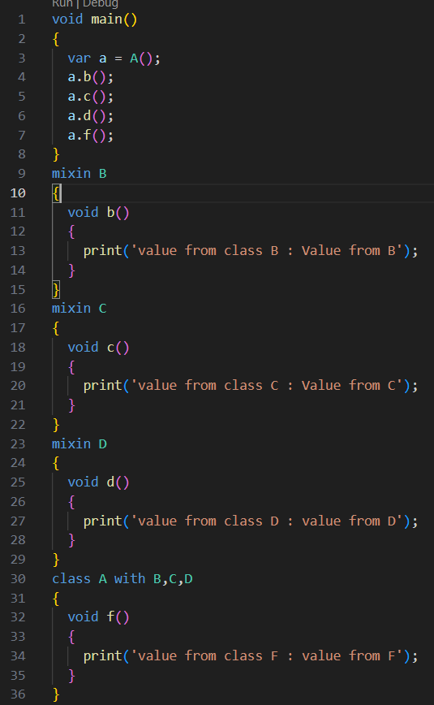
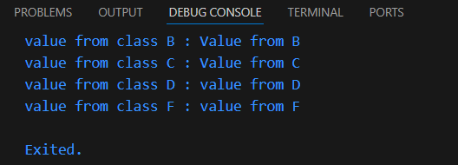
EXERCISE - 2

Slide 20
THANKYOU ! !

